Slide 1

EVOLUTION OF MANAGEMENT THOUGHT
Jaskiran Kaur

Slide 2

Classical Approach
First study of management.
Emphasized rationality
Making organizations and workers as efficient as possible.

Slide 3
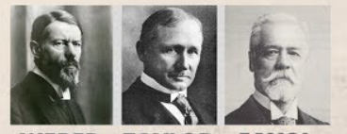
Contributors

Slide 4
Theories under Classical Approach
Assumption: People are rational
Scientific Management
Administrative Principles
Bureaucratic Organization

Slide 5

I. Scientific Management
Fredrick Winslow Taylor is known as father of Scientific Management.
An approach that involves using the scientific method to find the “ ONE BEST WAY” for a job to be done.

Slide 6
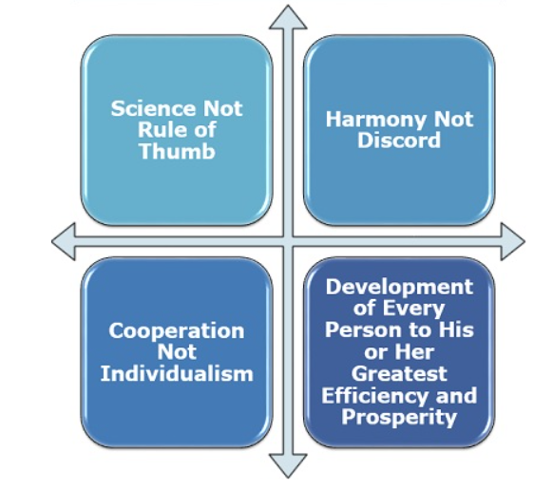
Principles of Scientific Management
Notes:
there should not be any conflict between the managers and the workers. He emphasised that there should be complete harmony between the managers and the workers.

Slide 7
How today’s Managers use Scientific Management???
Managers should develop standard methods for doing each job.
Select workers with the appropriate abilities.
Train workers in the standard methods.
Support workers by planning their work and eliminate interruptions.
Provide wage incentives to workers for increased output.

Slide 8

Application

Slide 9
McDonalds has all of their operations down to a science.
They are all about maximizing efficiency.
McDonalds’ main focus is speed.

Slide 10
They are not like typical restaurants where you can small chat with your waiter or waitress.
They want you in and out of the store or drive through as fast as humanly possible.
They make sure that they keep up to these standards by constantly monitoring operations and analyzing how they can be more efficient, productive, and make and sell the most amount of burgers and sandwiches possible during the day.

Slide 11
II. General Administrative
Contributor of this approach is Henry Fayol.
Focused on the productivity of total organization.

Slide 12
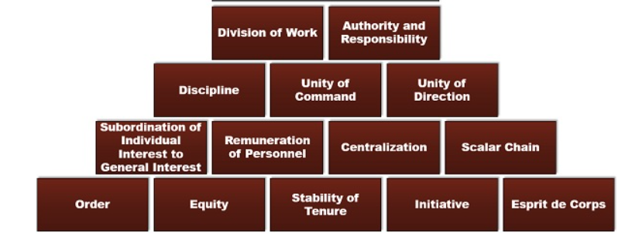
14 Principles of Management

Slide 13

1. Division of Work

Slide 14

2. Authority and Responsibility

Slide 15

3.Discipline

Slide 16

4. Unity of Command

Slide 17

5. Unity of Direction
Notes:
One unit and one plan' for the group of activities having the same objective is the essence of this principle

Slide 18
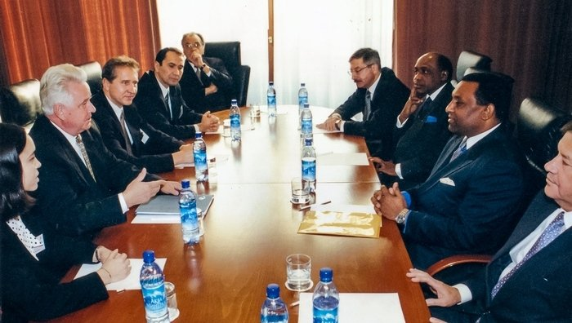
6. Subordination of Individual Interests to the general interest

Slide 19

7. Remuneration

Slide 20

8. Centralization

Slide 21

9. Scalar Chain
Notes:
A clear line of communication is very important for any organisation to achieve its objectives. The communication has to flow in an order for it to be effective. Scale chain identifies that path.

Slide 22
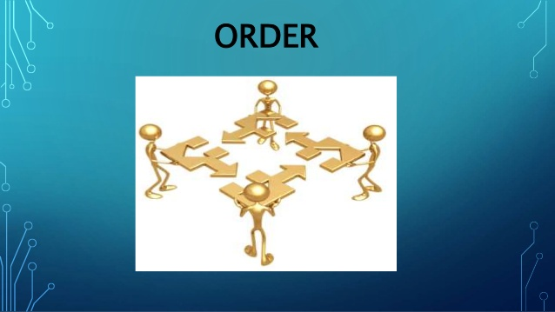
10. Order
Notes:
a place should be fixed for everything and everyone and everything and everyone should be in its place

Slide 23

11. Equity

Slide 24

12. Stability of tenure of personnel

Slide 25

13. Initiative

Slide 26

14. Esprit de Corps
Notes:
union is strength

Slide 27
III. Bureaucratic Organization
Max Weber introduced the concept of Bureaucratic Organization.
Bureaucracy is a form of organization characterized by division of labour, a clearly defined hierarchy, detailed rules and regulations, and impersonal relations.
A systematic approach that look at the organization as a whole is bureaucratic organization approach

Slide 28
Characteristics of Weber’s Bureaucracy
Impersonal Position
Rule governed decision making
Professionalism
Chain of command
Defined responsibility
Bounded authority

Slide 29
EXPERENTIAL EXERCISE
LET’S CHECK BUREAUCRACY LEVEL

Slide 30
Exercise
S.No. | Statement | Mostly Agree | Mostly Disagree
1. | I value stability in my job.
2. | Rules, policies and procedures generally frustrate me.
3. | I enjoy working for a firm that promotes employees based heavily on seniority.
4. | I would prefer some kind of freelance job to working for the government.
5. | I would be proud to work for the largest and most successful company in its field.
6. | Given a choice, I would rather make $90,000 a year as a VP in a small company then $100,000 a year as a middle manager in a large company.
7. | I would rather work directly for a single manager than on a team with shared responsibilities.
8. | I generally prefer to multitask and be involved in multiple projects.
9. | Good employee benefits are important to me.
10. | Rules are made to be broken.

Slide 31
Scoring
Give:
One point for each answer of Mostly agree to the odd numbered questions .
One point for each Mostly Disagree to the even numbered questions.

Slide 32

Interpretation
If score is 8-10 ----------- formal company would be compatible with your style and wishes.
4-7 ------------------ you would receive modest satisfaction from working within a bureaucratic organization.
1-3---------------you would likely be frustrated by working in a large bureaucracy.

Slide 33
Neo-Classical Approach
This theory is built on the base of classical theory.
Neo-classical theory gave greater emphasis to man behind the machine.
It stressed the importance of individual as well as group relationship in the workplace.
Also called as Human Relations and Behavioural Approach.

Slide 34
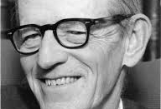
Contributor
ELTO MAYO

Slide 35
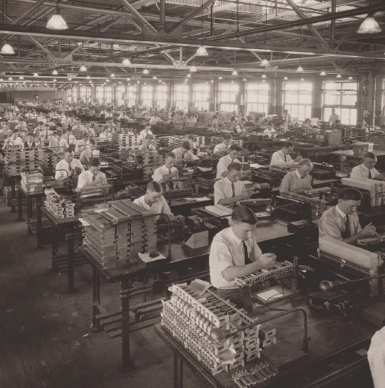
Hawthorne Study
A series of studies during the 1920s and 1930s that provided new insights into individual and group behaviour.
Conducted at Western Electric Company Works in Cicero, Illinois.

Slide 36

Hawthorne Study
Based on the idea that truly effective control comes from within the individual worker rather than from strict, authoritarian control.

Slide 37
4 Phases of Hawthorne Experiment
Experiments
Illumination Experiments
Relay Assembly Test Room Experiments
Mass Interviewing Programme
Bank Wiring Observation Room Experiment
1
2
3
4

Slide 38

Hawthorne Study Conclusion
The social and psychological factors are responsible for workers’ productivity and job satisfaction.
Only good physical working conditions are not enough to increase productivity.
The informal relations among workers influence the workers behavior and performance more than the formal relations in the organization.
Employees will perform better if they are allowed to participate in decision-making affecting their interests.

Slide 39
Modern Management Thoughts
Two theories
Contingency Theory
System Theory

Slide 40

1. Contingency Approach
A management approach that recognizes organizations as different, which means they face different situations and require different ways of managing.
There is no one universally applicable set of managerial principles by which to manage organizations.

Slide 41

Contingency Approach
A manager must be ready to change, to fit in with what’s best with the environment.
This approach stresses that there are no simplistic or universal rules for managers to follow.

Slide 42
In Simple words
“NO ONE BEST WAY TO DO THINGS”

Slide 43
Contingency Variables
Popular Variables
Organization Size
Routineness of Task Technology
Environmental Uncertainty
Individual Differences

Slide 44

Application of Contingency Theory
Manager will be able to identify and to solve problems under different situations.
Manager will be able to recognize that the successful application of a technique in one situation does not guarantee success in another.
Manager will be able to examine each situation in terms of how it is affected by the contextual, organizational and human dimensions.

Slide 45

2. System Approach
Let’s start with understanding of System
It is a set of different interdependent parts working together in interrelated manner to accomplish a set of objectives.

Slide 46
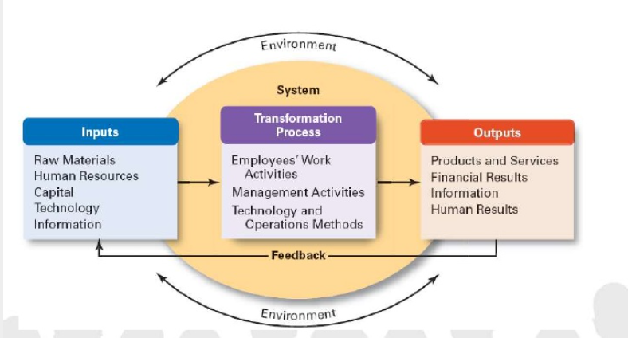
Elements of System Approach

Slide 47
Elements of System Approach
Organization as a system receives Input.
Transforms it through a Process for Output.
Operates in an Environment ( Economic, Regulatory and other forces)

Slide 48
Classification of Systems
System
Open System
Closed System

Slide 49

EXAMPLE

Slide 50

Example
A shift manager at a Starbucks restaurant who must coordinate the work of employees filling customer orders at the front counter and the drive-through windows,
Direct the delivery and unloading of food supplies,
And address any customer concerns that come up.

Slide 51

Example
This shift manager “Manages” all parts of the “System” so that restaurant meets its daily sales goals.

Slide 52
Hawthorne Study
Employees will also work more efficiently , when they believe that the management is interested in their welfare.
When employees are treated with respect and dignity, their performance will improve.
Financial incentives alone cannot increase the performance.

